Slide 1
QUALITY OF EDUCATION IN SCHOOLS: THE STATE OF ATTAINMENT OF LEARNERS
Presentation
By
Directorate of Quality Assurance
(DQAS)

Slide 2
OVERVIEW OF THE PRESENTATION
Introduction
Status of attainment levels
Reasons for low attainment levels by learners
Conclusion

Slide 3
Introduction
The Ministry of Education (MoE) is mandated to provide quality and relevant education to Malawian citizens irrespective of race, ethnicity, gender, religion, disability or any other discriminatory characteristics (Education Act 2013).
The mandate of the directorate is to establish and promote the highest standards of quality in education provision
The MoE is investing a lot of financial resources to ensure provision of quality education

Slide 4
Performance of learners
Studies have however revealed low attainment levels by learners across the country. For example, The Multiple indicator cluster survey of 2020 indicates that only 19 % of children aged 7 to 14 years have foundational reading skills in either Chichewa or English and that 13% of the same age range have foundation numeracy skills
National Reading Assessment (NRA) 2021 shows that most of our Std 2 and 4 learners are non readers
In addition, inspection findings show that learner attainment across the school is either at minimum or below minimum standards. Refer to graph

Slide 5
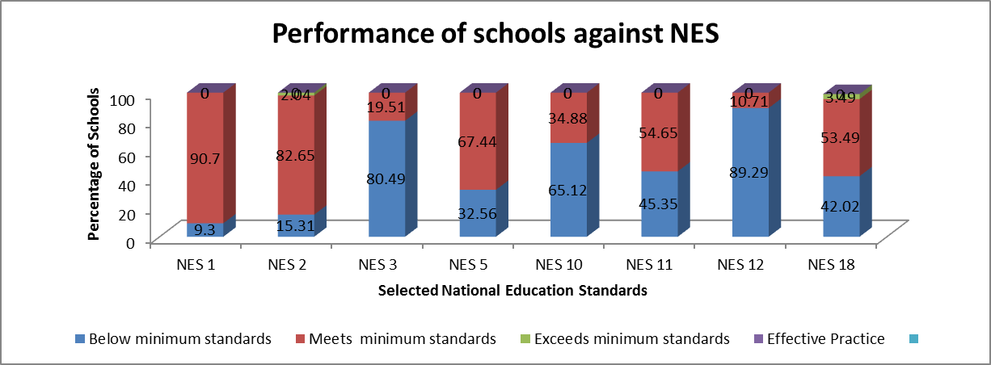
Performance of Schools against NES

Slide 6
This rest of the presentation therefore highlights some of the reasons leading to low attainment levels by learners in schools
Will focus at the following areas
  Supply and infrastructure factors
  Leadership and management
  Teaching process
  Student factors

Slide 7
Reasons for low attainment:
A. Supply and Infrastructure factors
Inadequate teachers in rural schools : This is mostly due to lack of accommodation in schools in remote areas. Teachers travel long distances to and from schools because of lack of descent accommodation.
Inadequate classrooms and poor quality of infrastructure in some schools which leads to overcrowding and congestion in classrooms, hence teachers fail to give individual help to learners
Inadequate teaching and learning resources (textbooks and others) which makes it difficult for teachers to effectively deliver lessons in schools (late SIG& funding for CDSSs)

Slide 8
B. Leadership and Management
Poor leadership skills by school managers which leads to ineffective management of teachers because most management positions like Head teachers and HODs are filled on administrative arrangements and not merit
Delays in processing teacher discipline cases. This promotes indiscipline among teachers as those affected are just transferred from one school to another.
Inadequate school based supervision, hence causing lack of monitoring of curriculum coverage by teachers.
Uneven distribution of teachers with Urban schools having more and qualified than rural schools
Overstaying of head teachers at one school and they gradually loose sense of commitment to duty

Slide 9
C. Teaching Process
Most teachers lack competency; some teachers lack content knowledge as a result they skip some topics in the syllabus.
Teachers do not thoroughly prepare for lessons. Inspection reports show lack of schemes of work and lesson plans; and lack of preparation for teaching and learning resources to complement the teaching process.
Poor management of time to maximize teacher pupil contact time due to teachers absenteeism, reporting late for lessons and ending the lesson early due to lack of preparation . An accumulation of such lost time leads to poor coverage of curriculum.

Slide 10
Continued…
Lack of regular continuous assessment in the teaching and learning process. For example teachers do not give written exercises and home work. Other teachers give assessment but no feedback is given to students.
Inadequate Continuing Professional Development for teachers
Wrong implementation of good practice: Most teachers/schools think student performance is a primary indicator for an effective teaching/ school; this mindset overshadows the primary goal of educating children since teachers concentrate on teaching Std 8 and form 4 students more than others in non-examination classes??

Slide 11
D. STUDENT FACTORS
Learner absenteeism (21%)and poor school attendance:
  household chores,
  market days,
  hunger,
  long distance to school
Limited parental support in school work

Slide 12
Conclusion
Learning attainment is indeed low but the Ministry and partners are working tirelessly in addressing these challenges
We need to critically reflect on what is happening in the classroom so we can improve our learning outcomes
Teachers need to be supported to ensure that teaching and learning process is indeed taking place.
We need more collaboration from all stakeholders to improve the situation

Slide 13
NEXT STEPS TO TRANSFORM EDUCATION
Adequate resourcing of the curriculum at all levels (Basic, Secondary, Higher) – financing (mobilize more resources, improving equity in distribution across subsectors)
Strict Enforcement of policies and guideline e.g Teacher Code of Conduct, Teacher deployment guidelines, National Standards of Education, Supervision framework
Intensify oversight roles/responsibilities across the system from SE, Directors at HQ to the district and school level for the system to be self propelling
Development of systems such as Digitalization of Inspection, teacher management system EMIS for readily available data for decision making to improve efficiency in the management of the system,
Teacher preparation in TTI needs to be thorough and relevant to current situation on the ground so teachers are able to handle all content in areas of specialization.
Inservice training should be intensified to fill the skills gaps in teacher and it should be well coordinate

Slide 14
I thank you for your kind attention

